Slide 1
Computer Organization and Assembly Fall 2019
Lecture 25
All Slides are courtesy by Dr Haroon
Syeda Farwa Batool

Slide 2
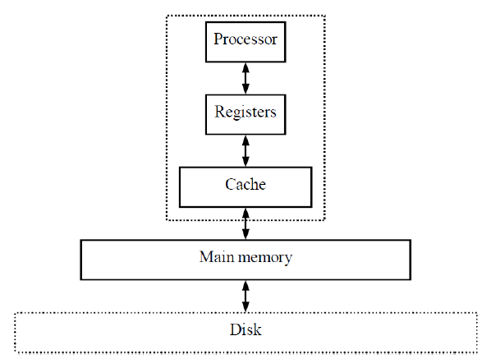
Memory Hierarchy
Out Motive: Want inexpensive, fast memory
Main memory
Large, inexpensive, slow
memory stores entire
program and data
Cache
Small, expensive, fast
memory stores copy of likely
accessed parts of larger memory
Can be multiple levels of cache

Slide 3
Cache
Usually designed with SRAM
faster but more expensive than DRAM
Usually on same chip as processor
space limited, so much smaller than off-chip main memory
faster access ( 1 cycle vs. several cycles for main memory)
Cache operation:
Request for main memory access (read or write)
First, check cache for copy

Slide 4
Cache
Cache hit
copy is in cache, quick access
Cache miss
copy not in cache, read address and possibly its neighbors into cache
Several cache design choices
cache mapping
replacement policies
write techniques

Slide 5
Problem 1
Assume a program that has:
cache access times of 1-cyc (L1), 10-cyc (L2), 30-cyc (L3), and 300-cyc (memory)
and Misses Per Kilo Instructions (MPKIs) of 20 (L1), 10 (L2), and 5 (L3).
Find the total memory access time.
Find memory access time without L3.
With L3: 1000 + 10x20 + 30x10 + 300x5 = 3000
Without L3: 1000 + 10x20 + 10x300 = 4200

Slide 6
Cache mapping
Far fewer number of available cache addresses
Are address’ contents in cache?
Cache mapping used to assign main memory address to cache address and determine hit or miss
Three basic techniques:
Direct mapping
Fully associative mapping
Set-associative mapping

Slide 7
Direct mapping
Main memory address divided into 2 fields
Index
cache address
number of bits determined by cache size
Tag
compared with tag stored in cache at address indicated by index
if tags match, check valid bit
Valid bit
indicates whether data in slot has been loaded from memory
Offset
used to find particular word in cache line

Slide 8
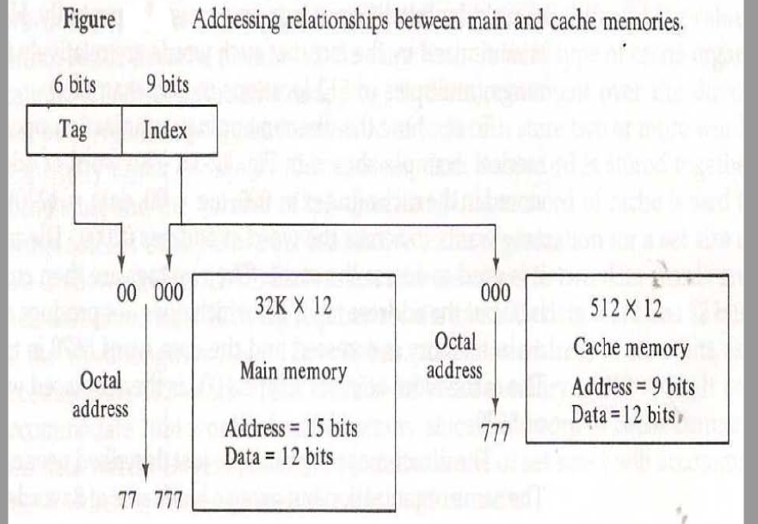

Slide 9
Memory Locality
Memory hierarchies take advantage of memory locality.
Memory locality is the principle that future memory accesses are near past accesses.
Memories take advantage of two types of locality
Temporal locality --near in time
we will often access the same data again very soon
Spatial locality --near in space/distance
our next access is often very close to our last access (or recent accesses).

Slide 10
Types of Cache Misses
Compulsory misses:
Happens the first time a memory word is accessed –the misses for an infinite cache
Capacity misses:
Happens because the program touched many other words before re-touching the same word –the misses for a fully-associative cache
Conflict misses:
Happens because two words map to the same location in the cache –the misses generated while moving from a fully-associative to a direct-mapped cache

Slide 11
Problem 1
Assume a direct-mapped cache with just 4 sets. Assume that block A maps to set 0, B to 1, C to 2, D to 3, E to 0, and so on. For the following access pattern, estimate the hits and misses:
A B B E C C A D B F A E G C G A
M M H M M H M M H M H M M M M M

Slide 12
Problem 2
Assume a 2-way set-associative cache with just 2 sets. Assume that block A maps to set 0, B to 1, C to 0, D to 1, E to 0, and so on. For the following access pattern, estimate the hits and misses:
A B B E C C A D B F A E G C G A

Slide 13
Set-Associative Mapping
Cache lines are grouped into sets where each set contains k number of frames.
A particular block of main memory can map to only one particular set of the cache.
However, within that set, the memory block can map to any freely available cache line.
The set of the cache to which a particular block of the main memory can map is given by-

Slide 14
Cache set number
Cache set number= (Main Memory Block Address ) % (Number of sets in Cache)

Slide 15
The following steps explain the working of set associative cache-
After CPU generates a memory request,
The set number field of the address is used to access the particular set of the cache.
The tag field of the CPU address is then compared with the tags of all k lines within that set.
If the CPU tag matches to the tag of any cache line, a cache hit occurs.
If the CPU tag does not match to the tag of any cache line, a cache miss occurs.
In case of a cache miss, the required word has to be brought from the main memory.
If the cache is full, a replacement is made in accordance with the employed replacement policy.

Slide 16
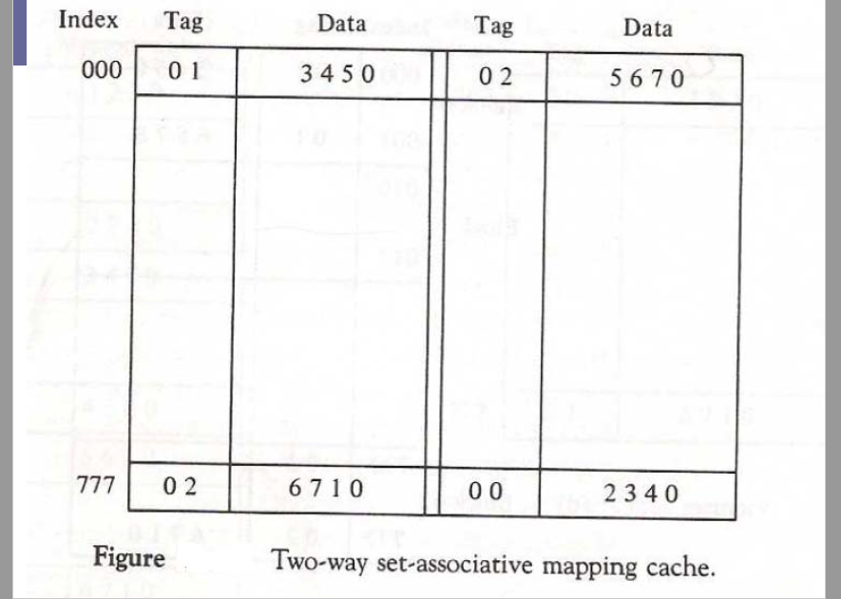

Slide 17
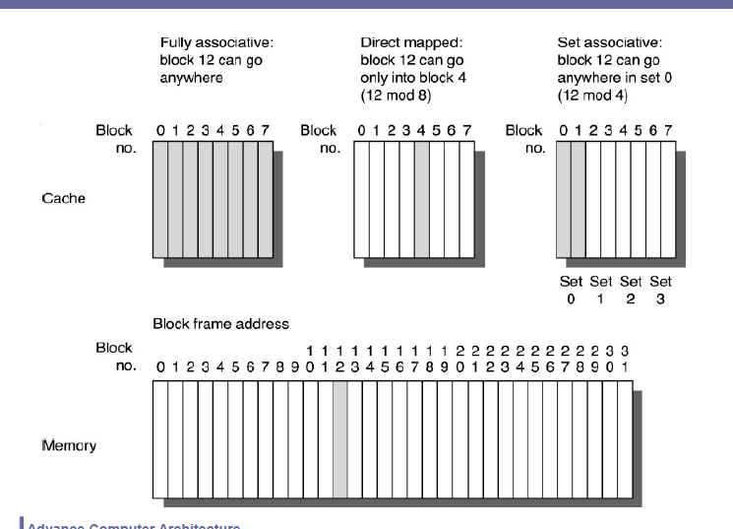

Slide 18
Fully associative mapping,
A block of main memory can be mapped to any freely available cache line.
This makes fully associative mapping more flexible than direct mapping.
A replacement algorithm is needed to replace a block if the cache is full.

Slide 19
Technique for choosing which block to replace
When fully associative cache is full
When set-associative cache’s line is full
Direct mapped cache has no choice
Random
replace block chosen at random
LRU: least-recently used
replace block not accessed for longest time
FIFO: first-in-first-out
push block onto queue when accessed
choose block to replace by popping queue

Slide 20
Problem-01:
Consider a fully associative mapped cache of size 16 KB with Page size 256 bytes. The size of main memory is 128 KB.
Find:
Number of bits in tag
Tag directory size

Slide 21
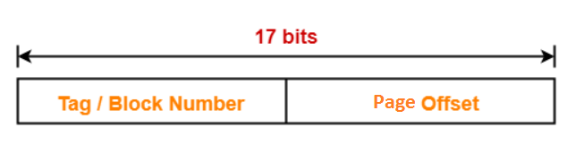
Given
Cache memory size = 16 KB
Block size = Frame size = Line size = 256 bytes
Main memory size = 128 KB
Size of main memory = 128 KB
Size of main memory = 2¹⁷ bytes
Thus, Number of bits in physical address = 17 bits

Slide 22
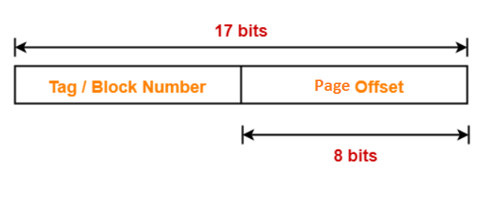
Number of bits in block offset
We have,
Page size = 256 bytes
Page size = 2⁸ bytes
Thus, Number of bits in block offset = 8 bits

Slide 23
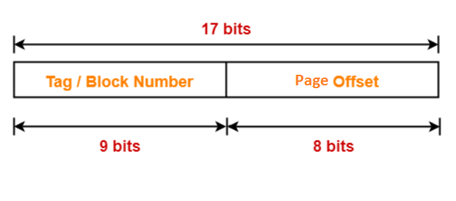
Number of bits in tag
Number of bits in tag = Number of bits in physical address – Number of bits in block offset
Number of bits in tag = 17 bits – 8 bits
Number of bits in tag = 9 bits
Thus, Number of bits in tag = 9 bits

Slide 24
Number of frames in Cache-
Total number of frames in cache = Cache size / frames size
= 16 KB / 256 bytes
= 2¹⁴ bytes / 2⁸ bytes
= 2⁶ lines

Slide 25
Tag Directory Size
Tag directory size = Number of tags x Tag size
= Number of frames in cache * Number of bits in tag
= 2⁶ x 9 bits
= 576 bits
= 72 bytes
Thus, size of tag directory = 72 bytes

Slide 26
Problem-02
Consider a fully associative mapped cache of size 512 KB with page size 1 KB. There are 17 bits in the tag. Find-
Size of main memory
Tag directory size
Notes:
Thus, size of tag directory = 1088 bytes

Slide 27
Problem-03
8 KB fully-associative data cache array with 64byte line sizes, assume a 40-bit address
How many sets?
How many ways?
How many index bits, offset bits, tag bits?

Slide 28
Problem-04
64 KB 16-way set-associative data cache array with 64 byte line sizes, assume a 40-bit address
How many sets?
How many index bits, offset bits, tag bits?

